Slide 1
Teamwork & Conflict resolution
Because working with people is unavoidable

Slide 2
A team…
Has shared goals and reasons for working together
Has members that are interdependent
Has members that are committed to the success of the whole group and the idea of cooperation
Is accountable to its members and the larger community

Slide 3
Team focus
All teams must balance between the small details and the big picture
The split between the details and the big pictured is referred to as the Task/Process Orientation

Slide 4
Task Oriented
Attention to detail
Independent work
Focus on the now
Closure

Slide 5
Task orientation
pros
cons
Gets things done
Quick decisions
Efficient
Considers the fine points
Can miss the big picture
Stifles creativity
Lack of communication
Lack of cohesion

Slide 6
Process orientation
Consideration of the team’s purpose
Multiple perspectives
Emphasis on the long term
Exploration of ideas

Slide 7
Process orientation
pros
cons
Encourages creativity
Explores ideas more deeply
Allows greater collaboration
Sets up and directs tasks
Can overlook the little details
Problems getting things done
Time consuming
Can be inefficient

Slide 8
Coming to consensus
Teams must decide how much emphasis is placed on task and process
Team members must all be on the “same page” once these decisions are made
Team members must abide by these decisions and take responsibility for their actions
One way to do this…

Slide 9
Working agreements
A working agreement consists of ground rules (norms, expectations) that guide how a team will work together to achieve results/meet an objective/realize a goal

Slide 10
Working agreements
Help a team develop a sense of shared responsibility.
Increase members’ awareness of their own behavior
Empower the facilitator to lead the group according to the agreements.
Enhance the quality of the group process.
Strike a balance between task and process

Slide 11
Agreements work well
If they are well developed
If they are enforced consistently
If each member of the team agrees to it

Slide 12
Agreements should include
Communication
Participation
Decision making
Conflict
Responsibilities and Consequences

Slide 13
Exercise from last time
What is a team?
What should a team do?
What type of teamwork experience do you want in this class?
Did you address communication, participation, decision making, conflict, responsibilities and consequences?

Slide 14
Your working agreement should include
Contact Information
Group norms- where, when, how
Group ground rules- consequences, decision-making, etc.
Group expectations- work quality, attendance, etc.
File Sharing Protocol
Individual Vision Statements
Rubric
Signatures

Slide 15
Examples of guidelines
Listen to other’s points of view without prejudice
Show up on time. If you cannot, you must contact the group
Be prepared for meetings
Be committed to ending on time (if possible)
Attack a problem, not a person

Slide 16
What does it look like?
Do’s and Don’ts
Guidelines
Results focused

Slide 17
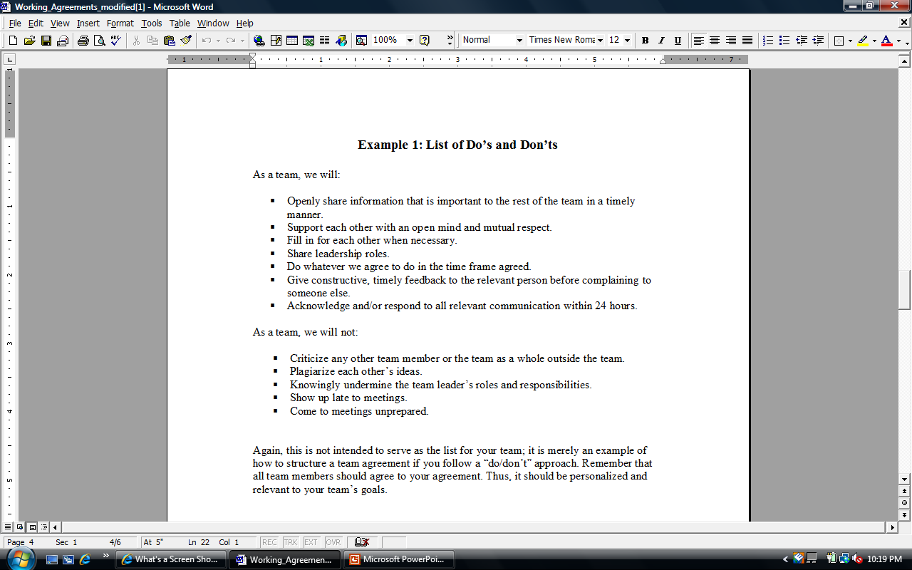

Slide 18
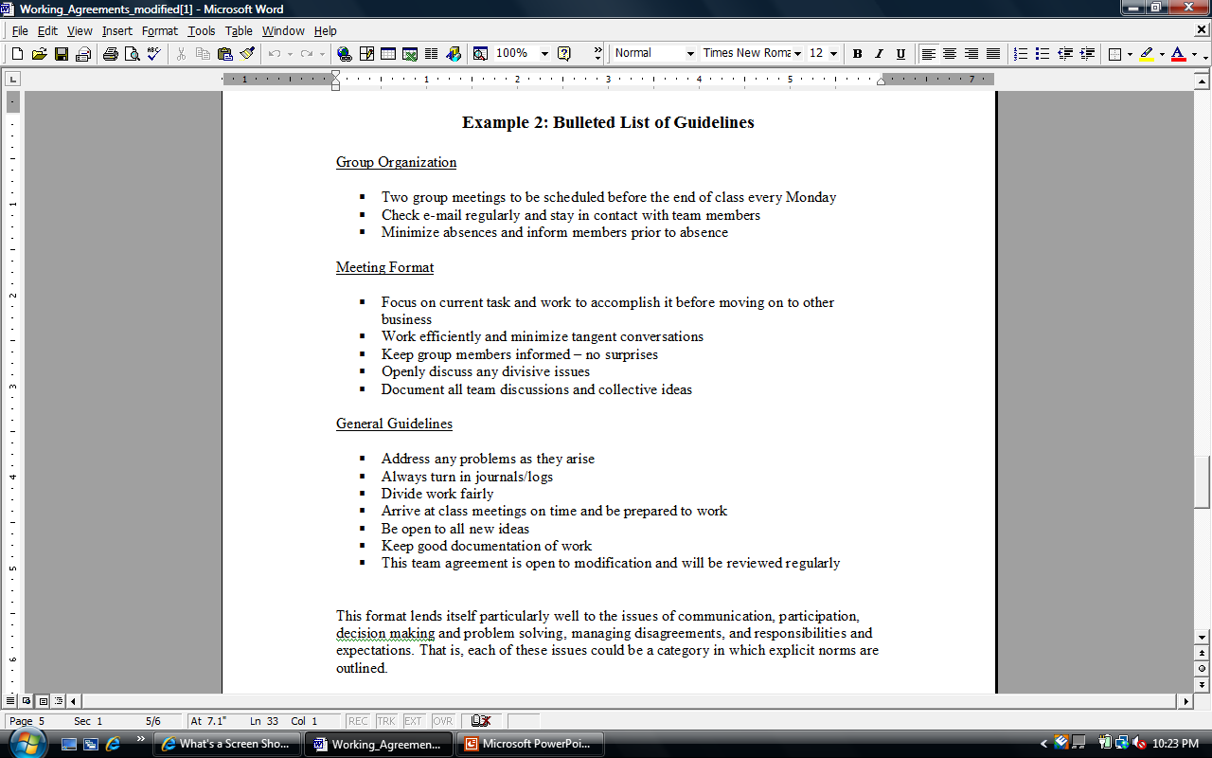

Slide 19
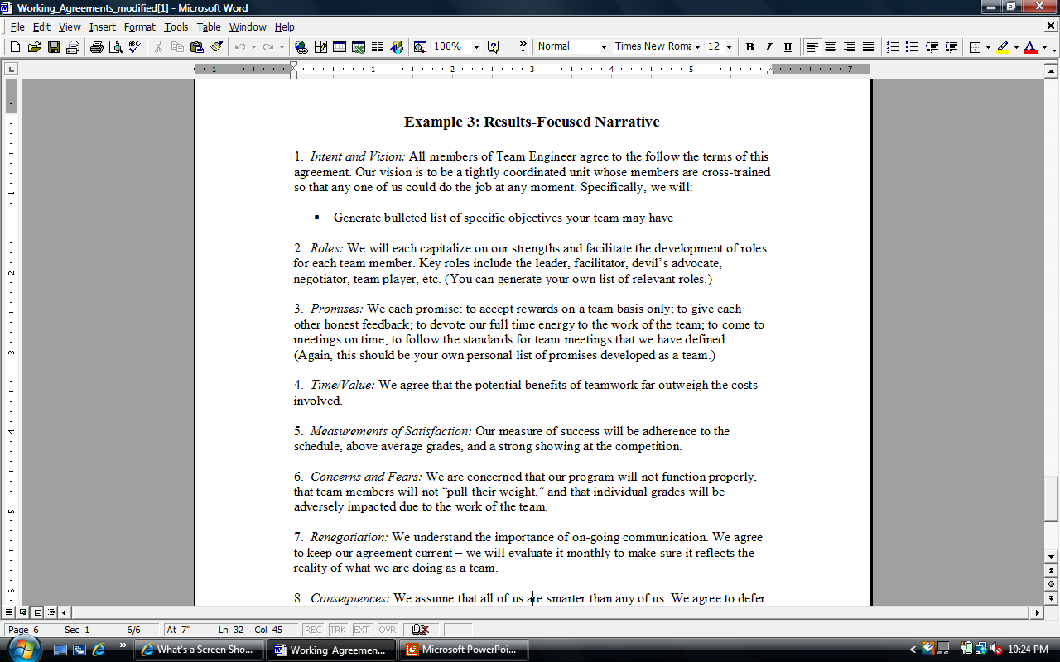

Slide 20
Team exercise
Get in teams
Share your answers from the individual exercise
Decide which type of working agreement your team is going to write
Start work on your agreement as a team; address the following elements:
Contact Information
Group norms- where, when, how
Group ground rules- consequences, decision-making, etc.
Group expectations- work quality, attendance, etc.

Slide 21
Conflict
All groups encounter conflict (both task and relational)
We think of conflict in negative terms: shouting, arguing, aggressive and passive resistance
Conflict is often interaction between different personality types
We often avoid and ignore conflict
We are often unaware of potentially positive outcomes of conflict
We must learn to manage conflict productively

Slide 22
Causes of conflict
Diverse/conflicting worldviews, values, attitudes, and personalities
Different needs, expectations, or technical opinions
Limited time and resources
Communication and scheduling problems
Ambiguous roles and leadership
Unclear administrative procedures, reward structures, and decision making strategies

Slide 23
conflict
task
interpersonal
Inspires creativity and improves team effectiveness
Increases decision quality and team cohesiveness
Needs to be expressed and explored
Diverts energy from the issue or activity
Compromises team cohesiveness and effectiveness
Promotes hostility, distrust, cynicism and disengagement
Needs to be identified, discussed, and reduced

Slide 24
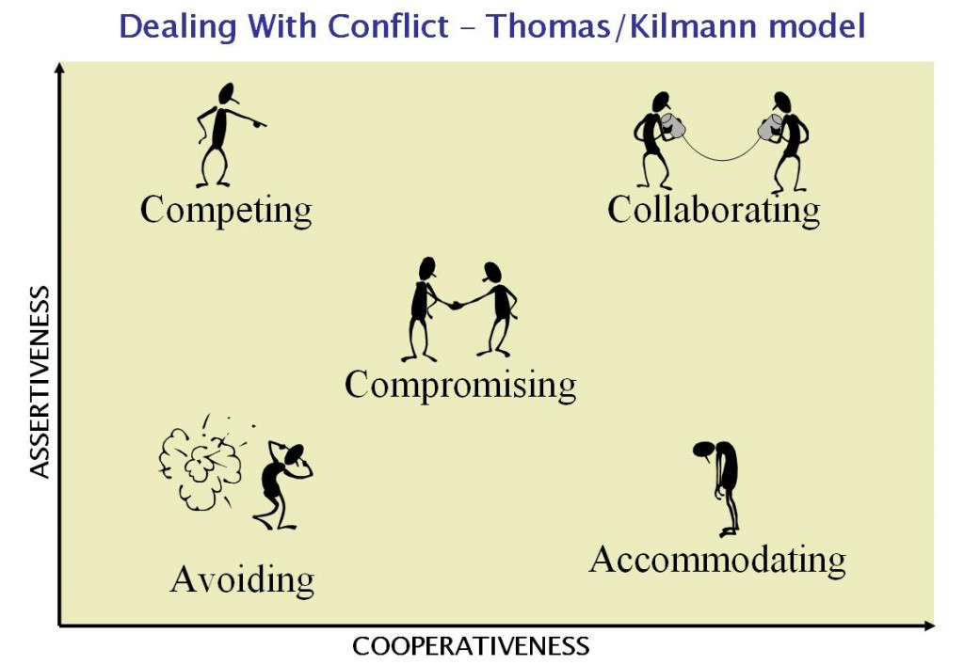
Conflict management styles

Slide 25
Dealing with conflict
Confront the opposition
Define the conflict mutually
Communicate feelings and positions
Communicate cooperative intentions
Take the other person’s perspective
Motivate to negotiate
Reach a mutually satisfying agreement

Slide 26
Common difficult behavior types
The Silent Type
The Monopolizer
The Intimidator
The Nice One
The Unhappy Camper

Slide 27
Responding to the silent type
Use silent idea generation
Establish a participation expectation at the outset
Be direct
Use break out sessions

Slide 28
Responding to the monopolizer
Be direct
Recognize their contributions
Capture the ideas in writing
Interrupt

Slide 29
Responding to the intimidator
Communicate that you understand their feelings
Explain that each members needs must be met as much as possible for a successful process

Slide 30
Responding to the nice one
Be direct
Check with each member to make sure they support the outcome of the session/meeting

Slide 31
Responding to the unhappy camper
Acknowledge their unhappiness
Get them involved by asking them to take on a responsibility (scribing)
Release them from the process
Work with a supervisor
Release them from the team

Slide 32
Communicate ethically
Treat everyone with respect and politeness
Speak with good intent
Ask questions with curiosity, not cynicism
Openly express disagreements
Avoid making attributions
Facilitate group process
Avoid coming to decisions too quickly
Respect confidentiality
Clarify opinions and statements with examples
Acknowledge others’ viewpoints and accept them as real

Slide 33
resolution
Take responsibility! Be open about problems with meeting guidelines, but be prepared to accept the consequences.
Seek assistance from supervisors and/or instructors for problems that are “too big.”
Don’t take it all on yourself. Picking up slack for other members leads to frustration, exhaustion and a reduction in quality of work.

